Slide 1
Digital Portfolio
STUDENT NAME: NANDHIKESAVAN V
REGISTER NO AND NMID:
DEPARTMENT: BSC Computer science
COLLEGE: COLLEGE/ UNIVERSITYOLLEGE Government Arts And Science College/ Thiruvalluvar University

Slide 2
PROJECT TITLE
Website create

Slide 3


AGENDA
Problem Statement
Project Overview
End Users
Tools and Technologies
Portfolio design and Layout
Features and Functionality
Results and Screenshots
Conclusion
Github Link
3/21/2024 Annual Review

Slide 4

PROBLEM STATEMENT
Here’s a problem statement in 5 lines for creating a website: 1. Many businesses and individuals struggle to establish a strong online presence. 2. Without a website, they cannot effectively showcase their products, services, or ideas. 3. Customers face difficulty finding reliable information in one place. 4. Existing solutions are often expensive or too complex for beginners. 5. A simple, user-friendly website can solve these challenges. Do you want me to write this in a formal project/problem statement format (like for academics), or in a short creative version for pitching?

Slide 5

PROJECT OVERVIEW
Here’s a sample Project Overview for a website creation project (simple and clear, 5–6 lines): --- Project Overview This project focuses on developing a user-friendly website that helps individuals or businesses build a strong online presence. The website will serve as a central platform to showcase products, services, or personal portfolios. It will include features like responsive design, easy navigation, and accessibility across devices. The goal is to make the platform simple enough for beginners yet scalable for growing needs. By providing an affordable and effective solution, the project aims to bridge the gap between users and their audiences. --- Would you like me to make this short (2–3 lines for quick notes) or detailed (like for a project report/academic submission)?

Slide 6

WHO ARE THE END USERS?
I think you mean “Who are the end users?” for the website project. Here’s a simple answer: End Users Small business owners who need an online presence. Students and professionals showcasing portfolios. Customers looking for information or services online. Beginners who want a simple, low-cost website. Organizations aiming to connect with a wider audience. 👉 Do you want me to write this in a formal academic style (like in a project report) or in a simple bullet list for notes?

Slide 7

TOOLS AND TECHNIQUES
Here’s a clear list of Tools and Techniques you can mention for a website creation project: Tools HTML, CSS, JavaScript → For front-end development Bootstrap / Tailwind CSS → For responsive design PHP / Node.js / Python (Django/Flask) → For back-end development MySQL / MongoDB → For database management WordPress / Wix → For quick, no-code website creation VS Code / Sublime Text → For coding environment Git & GitHub → For version control and collaboration Techniques Responsive Web Design (RWD) → To ensure the site works on all devices Agile Methodology → For iterative development and testing UI/UX Design Principles → To improve user experience SEO Optimization → To increase website visibility on search engines Testing (Unit & User Testing) → To ensure quality and performance Do you want me to prepare this in a tabular format (Tools | Purpose) so it looks neat for a project report?

Slide 8
When it comes to portfolio design and layout, the goal is to create something clean, professional, and easy to navigate while reflecting your personality or brand. Here are some structured ideas you can use: --- 🔹 Key Elements of a Portfolio 1. Cover Page / Introduction Your name, title (e.g., "UI/UX Designer", "Software Developer", "Content Creator") A tagline or short professional statement Clean visual or brand logo 2. About Me Short bio (who you are, your background, expertise) Skills overview (with icons or a skill bar) A professional photo (optional but adds trust) 3. Projects / Case Studies Showcase 3–6 best works (quality > quantity) For each project: Title + role Problem statement Your process (tools, methods, techniques) Final outcome (images, mockups, screenshots) Key impact/results 4. Tools & Techniques Use icons/logos for tools (e.g., Figma, Photoshop, Python, etc.) Mention soft skills (collaboration, design thinking, research) 5. Testimonials / Achievements (Optional) Quotes from clients/colleagues Certifications, awards, recognitions
POTFOLIO DESIGN AND LAYOUT
8

Slide 9
FEATURES AND FUNCTIONALITY
Here’s a simple 5-line version 👇 Features and Functionality of a Portfolio: 1. Provides a clear structure with About, Projects, Skills, and Contact sections. 2. Showcases best work with visuals, descriptions, and outcomes. 3. Ensures easy navigation and professional, consistent design. 4. Supports interactivity (links, animations, responsive design). 5. Highlights personal branding and enables quick contact/connection. Do you want me to also make this in a short table format for neat presentation?

Slide 10

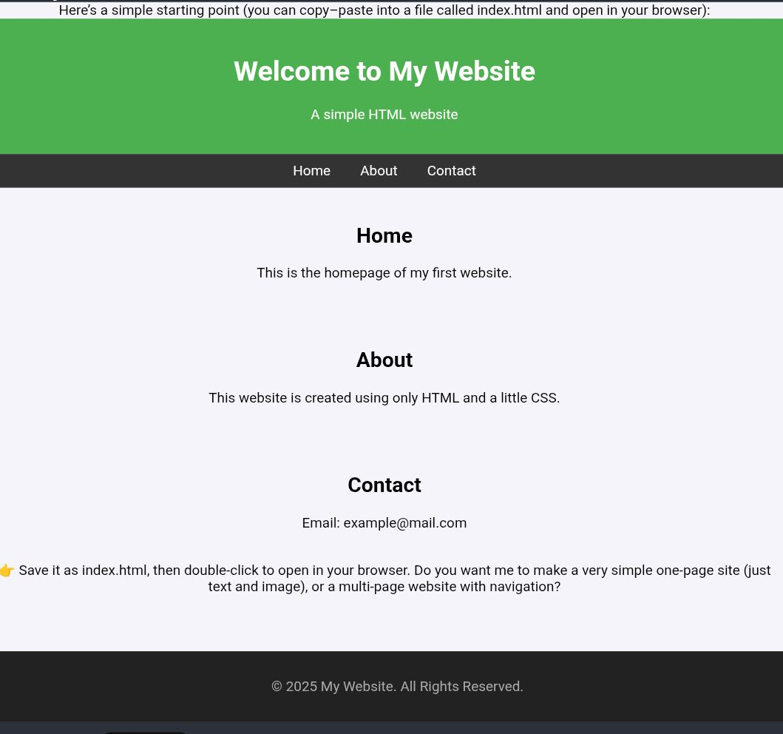
RESULTS AND SCREENSHOTS
3/21/2024 Annual Review
10

Slide 11
CONCLUSION
Here’s a simple conclusion for a website creation project: Conclusion: Creating a website involves planning, designing, and developing to meet the needs of users while achieving business goals. It requires the use of tools like HTML, CSS, and JavaScript to ensure both functionality and visual appeal. A well-structured website improves accessibility, user experience, and communication. By combining creativity with technology, websites become powerful platforms for sharing information and engaging with audiences. Do you want me to write this in short 3–4 lines (for a school/college project report) or in a detailed professional style (for documentation/portfolio)?
11

Slide 12
GitHub link
https://github.com/24csnm48-stack/Naan-mudhalvan.git

